Slide 1

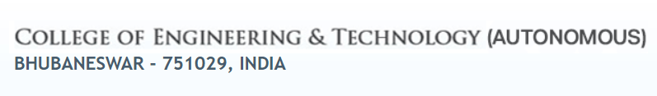
Department of Computer Science and Engineering A Project On Phishing Sites Predictor
Submitted by :-
Ashish Kumar Sahu 1801106122
Sridhar Prasad Dash 1801106536
Srijeeth Panda 1801106537
Debasish Behera 1921106026
Guided By :-
Ms Arunima Hota
Dept. of Computer Science and Engineering,
CET-B

Slide 2
Contents
Introduction
Objective
Methodology
Overview
Working
Model Deployment
Conclusion
References

Slide 3
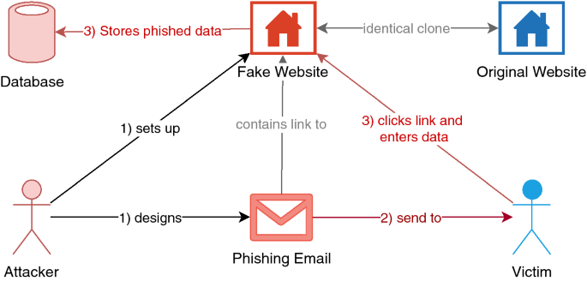
Introduction
Phishing is a cybercrime in which a target or targets are contacted by email, telephone or text message by someone posing as a legitimate institution to lure individuals into providing sensitive data such as personally identifiable information, banking and credit card details, and passwords.
This information is then used to access important accounts and can result in identity theft and financial loss.

Slide 4

Objective:-
Building/ Training a Model to predict whether the website is a Phishing website or not.
Predicting and stopping fraudulent websites is a critical step towards protecting online transactions.

Slide 5
Methodology :-
Collection Of Data
Split the Data into Train and Test set
Build The Model
Import Links to Prediction
Train The Model
Results
Deploy The Model

Slide 6

Project Overview :-
Target Label
Phishing Site
Not Phishing Site
Classifier
Training links
Testing links

Slide 7
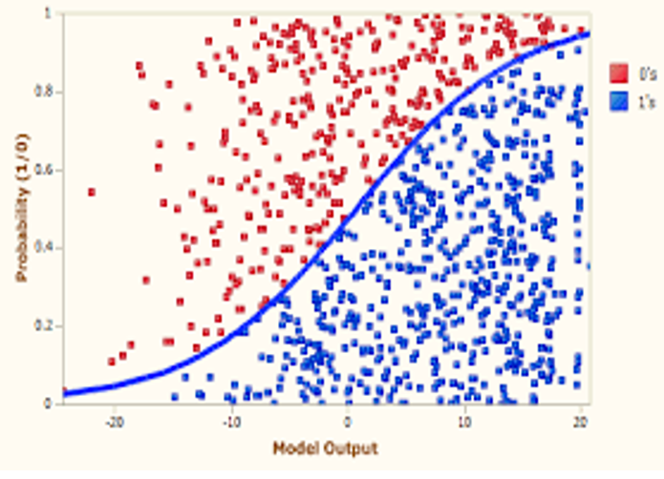
Working :-
Pulling
Tokenizes
Transforms Text
Converting
Fit Data
Results

Slide 8
Working In Detail :-
Used Libraries :-
import pandas as pd - use for data manipulation and analysis
import numpy as np - use for multi-dimensional array and matrix
import seaborn as sns - use for high-level interface for drawing attractive and informative statistical graphics
import matplotlib.pyplot as plt - It provides an object-oriented API for embedding plots into applications
from sklearn.linear_model import LogisticRegression - algo use to predict good or bad
from sklearn.naive_bayes import MultinomialNB - nlp algo use to predict good or bad
from selenium import webdriver - use for automation chrome
import pickle - use to dump model
API Used :- FASTAPI
Algorithms Used :– Logical Regression
MultinomialNB

Slide 9
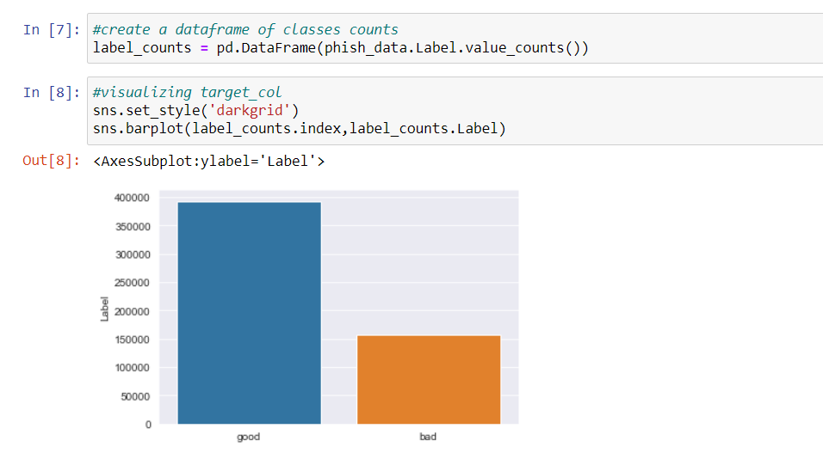
Read the dataset present in the csv file
A Bar Graph representing the count of Good and Bad sites present in the dataset.

Slide 10
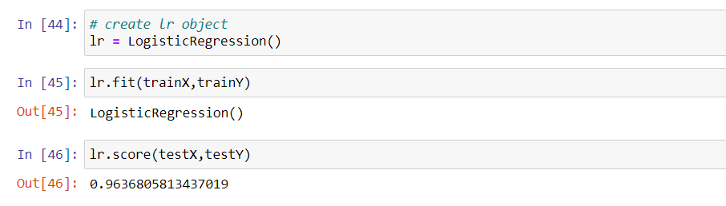
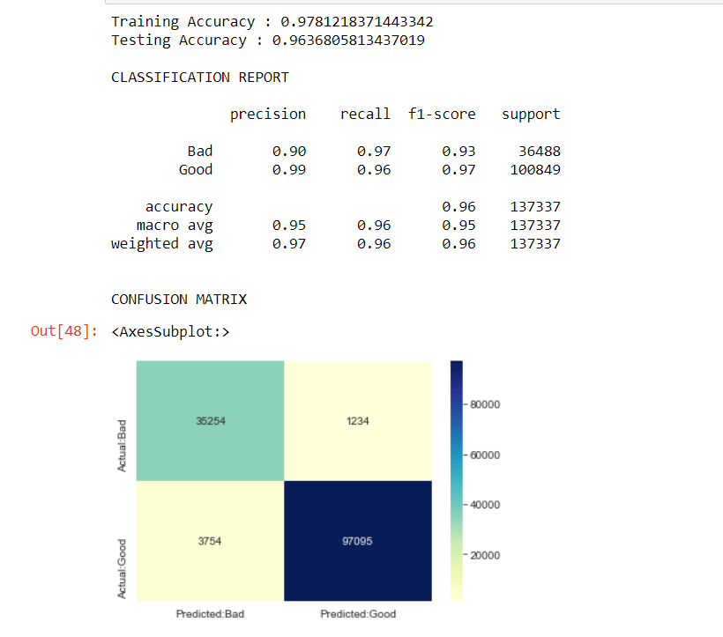
Logistic Regression Algorithm
Accuracy of LR algo

Slide 11
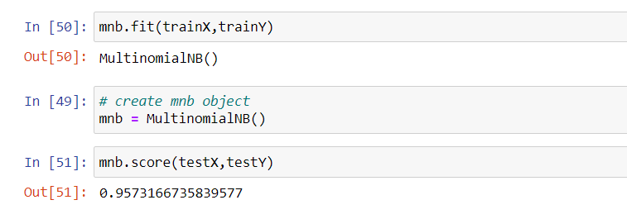
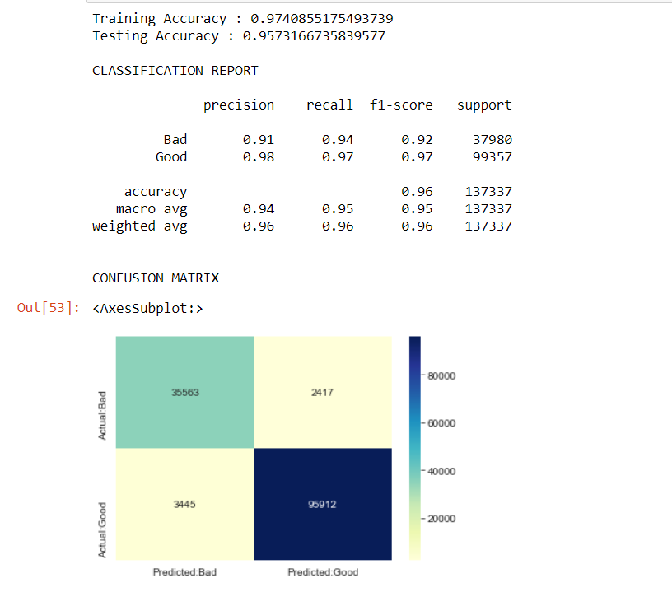
MultinomialNB Algorithm
Accuracy of MultinomialNB algo

Slide 12
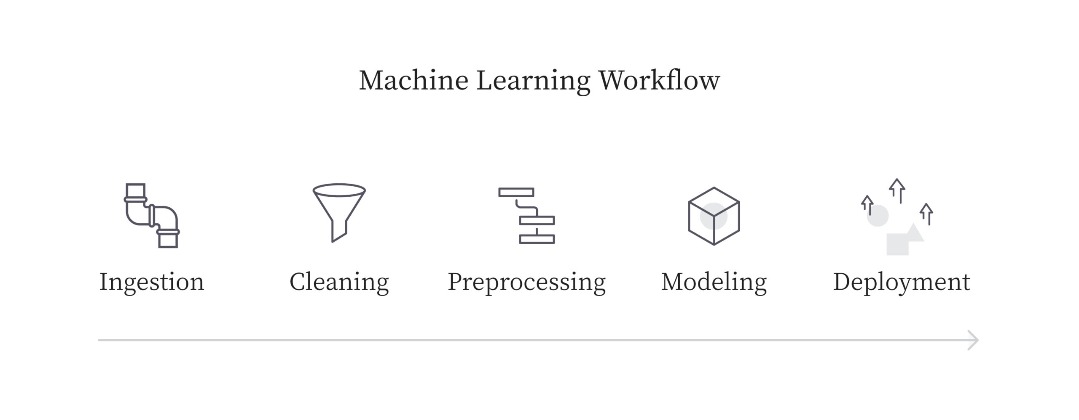
Pipelining the Model
ML pipeline is a means of automating the machine learning workflow by enabling data to be transformed and correlated into a model that can then be analysed to achieve outputs.
This type of ML pipeline makes the process of inputting data into ML model fully automated.

Slide 13
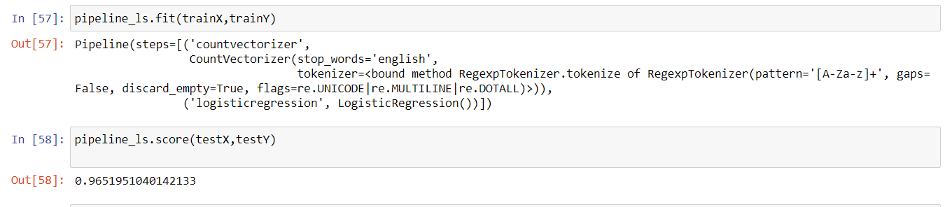
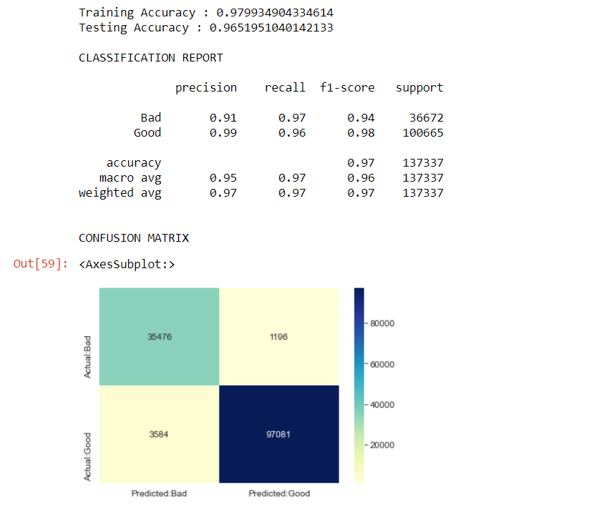
Pipelining the Model
Accuracy after Pipelining

Slide 14
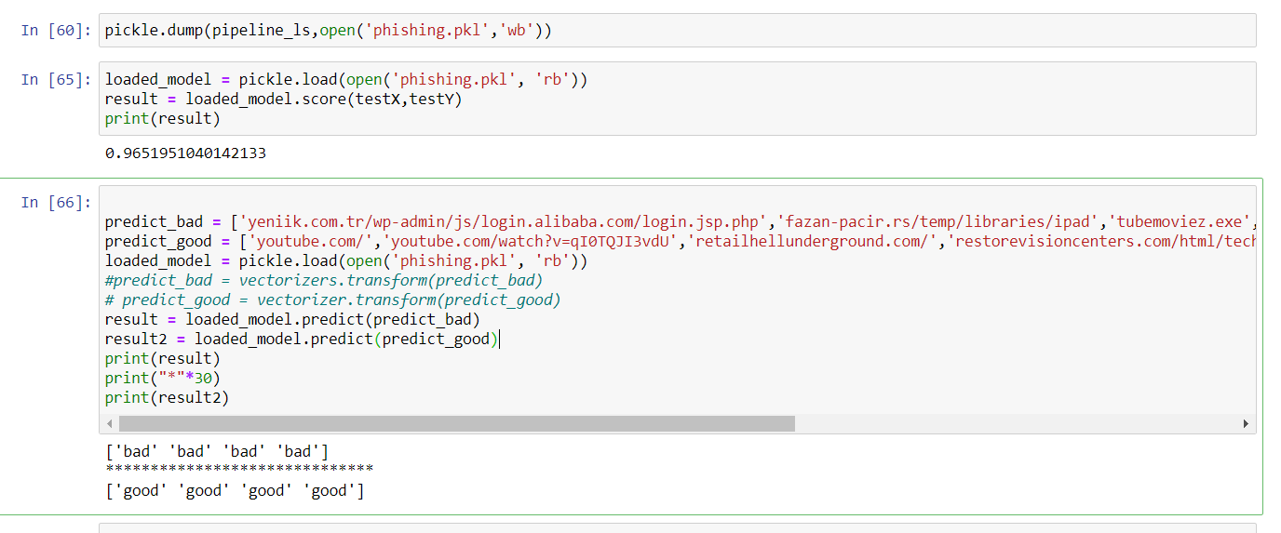
Create the Model File
We dump the model into a pkl file and use it in the main function.

Slide 15
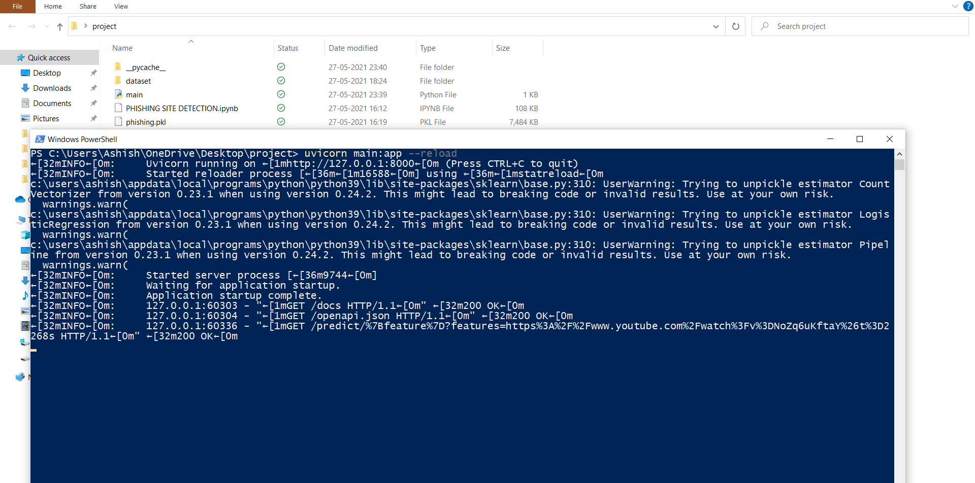
Model Deployment using FASTAPI
Open the PowerShell/Command Prompt and Enter
“ uvicorn main:app --reload”

Slide 16
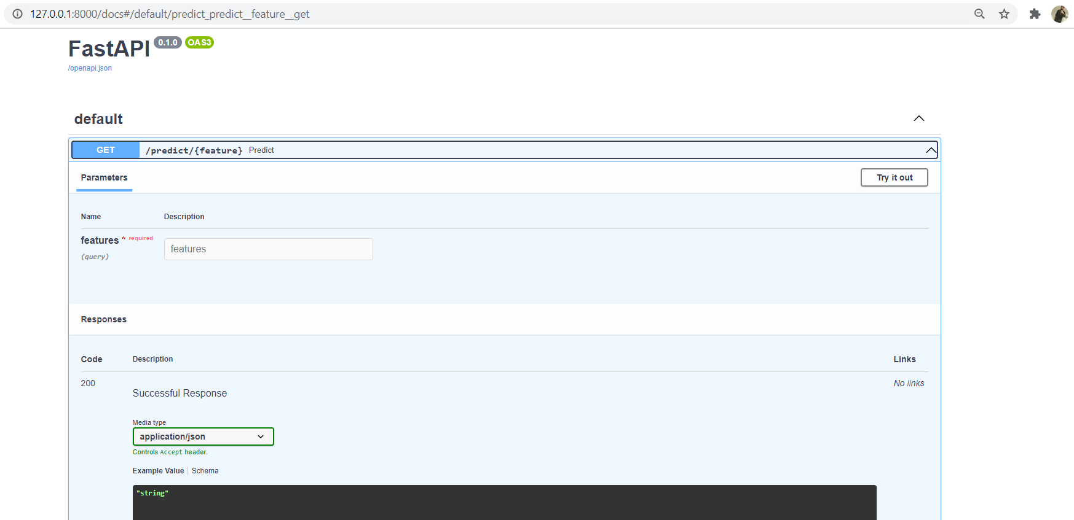

How To Use :-
After Deploying the Model, open your Browser and enter the Local Host Address
“ 127.0.0.1:8000/docs” and Press Enter.
Click Here to Enter the Site

Slide 17
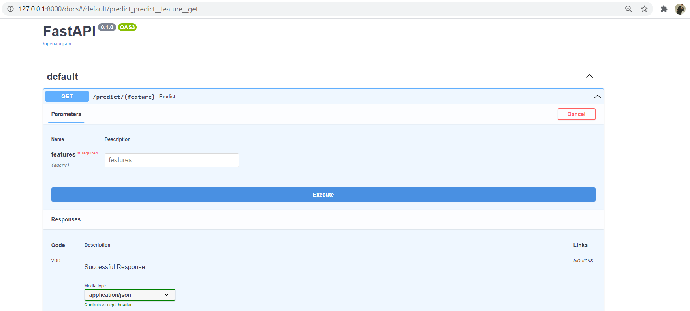
How To Use :-
Enter the Website here to Check
Click on Execute

Slide 18
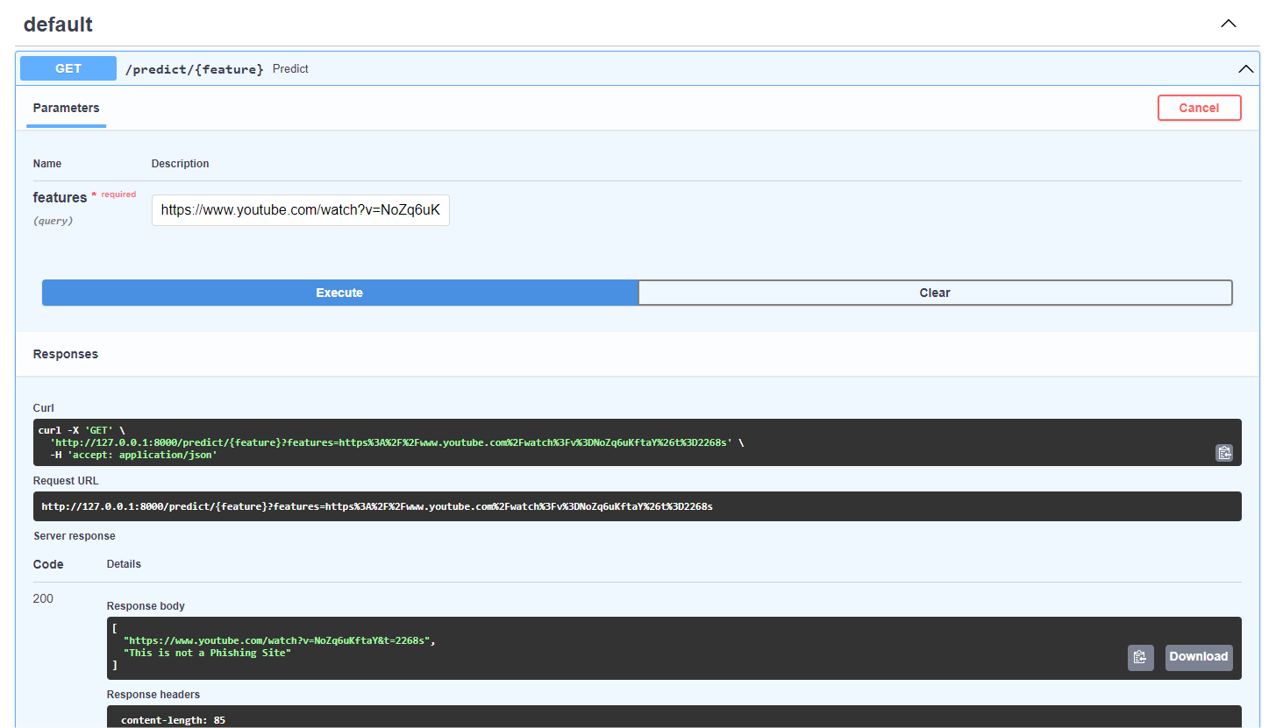
Predicting Good Sites
Giving Inputs in URLs
You can see the Model is Predicting the correct Output

Slide 19
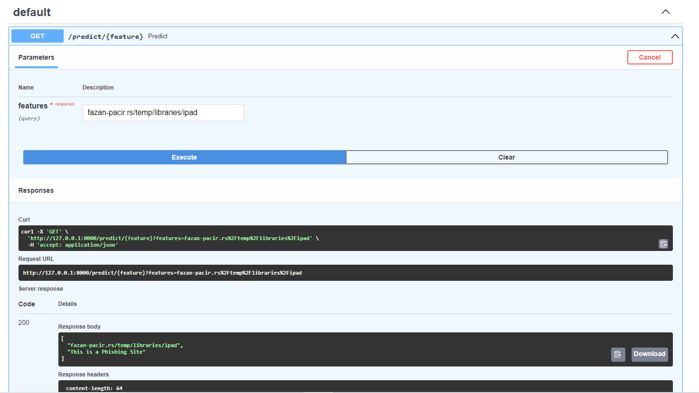
Predicting Phishing Sites
Giving Inputs in URLs
You can see the Model is Predicting the correct Output

Slide 20
Conclusion :-
Phishing websites are expected to be more stylish in the future. Therefore, predicting and blocking phishing websites is a critical step towards a untroubled internet experience.
This Predictor successfully and accurately overcomes that crucial problem and is faster than other web applications since it is deployed using FastAPI.

Slide 21
References :-
https://books.google.co.in/books?hl=en&lr=&id=7sYpEAAAQBAJ&oi=fnd&pg=PA143&dq=phishing+prediction
https://www.phishing.org/what-is-phishing
https://en.wikipedia.org/wiki/Phishing
https://www.imperva.com/learn/application-security/phishing-attack-scam/

Slide 22
Thank You

